Slide 1

Earliest deadline late
Zafirul Izzat Bin Mohamad Zaidi

Slide 2
REAL TIME SYSTEM
Real time systems are computer systems that have timing constraints imposed on their actions.
Hard real time system and soft real time system.
Scheduling plays a big role.

Slide 3
SERVER
Fix priority server
Dynamic priority server
Running time of the tasks follows the deadline according to its period.
scheduled based on a fixed priority assignment.
Example using Rate Monotonic Algorithm.
Able to change the CPU need for a task throughout run time.
Deadline can be extended.
Allows you to fit more tasks into a shorter time frame.
Example using Earliest Deadline Late.

Slide 4
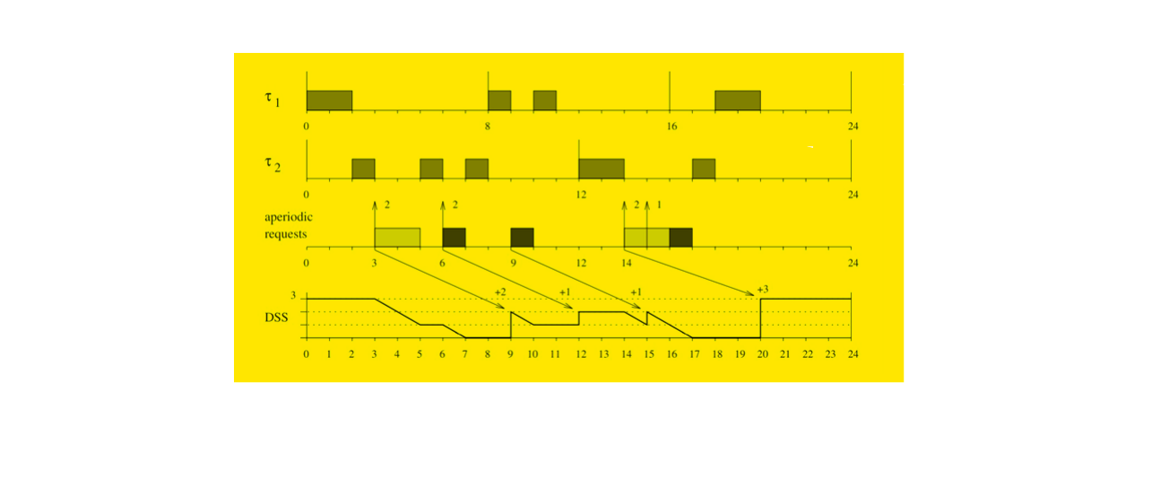
Problem
DYNAMIC SPORADIC SERVER
Designed to operate effectively under a dynamic Earliest Deadline First.
Has a period Ts time and a Cs capacity.
The periods of replenishment are determined by a replenishment rule.
Replenishment time and deadline are determined. RT1 = ds = Ta(3) + Ts(6) = 9.
Sporadic server technique may take a long time.

Slide 5
Solution
WHAT IS EDL?
EARLIEST DEADLINE LATE
Dynamic version of the Slack Stealing algorithm.
Take advantage of the laxities.
Aperiodic task totally depends on idle time.
Periodic tasks are schedule as late as possible.

Slide 6
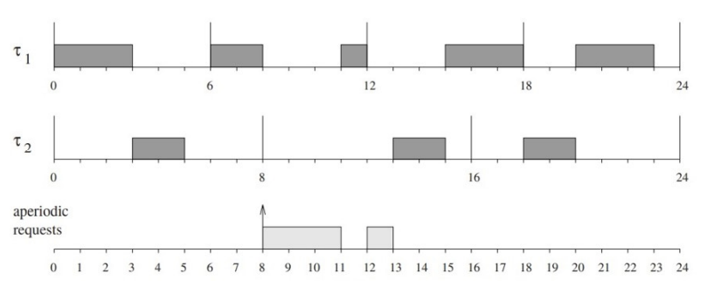
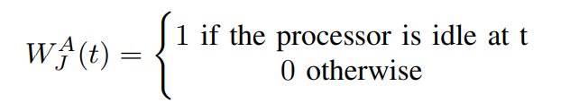
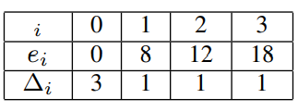
Solution
Utilizes the available slack of periodic tasks to be safely pre empted.
Aperiodic tasks will run whenever there is idle time.
EARLIEST DEADLINE LATE

Slide 7
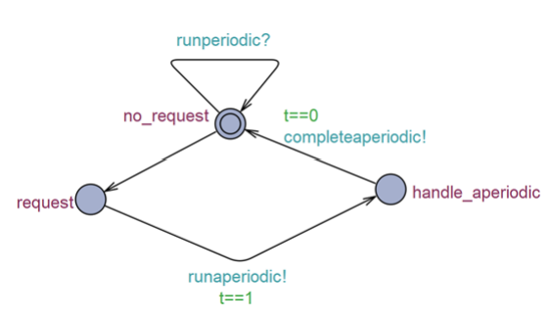
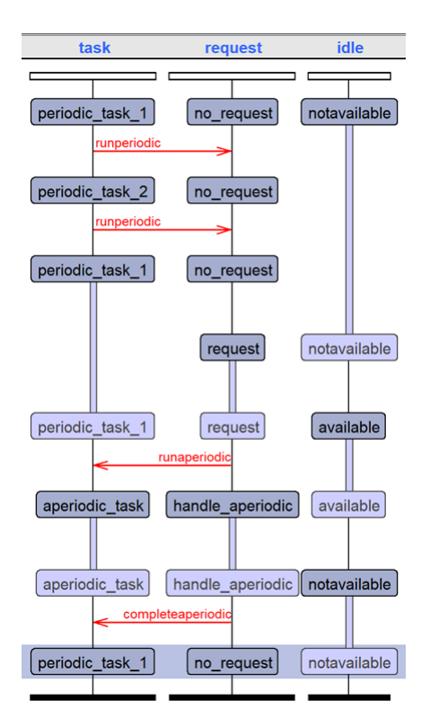
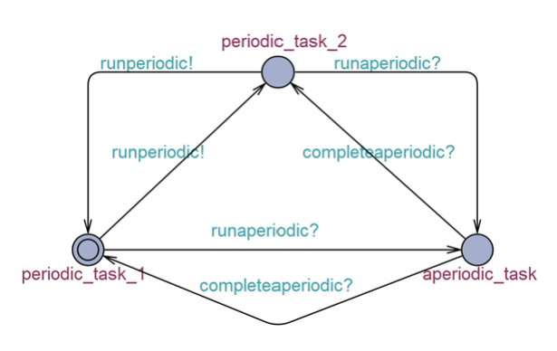
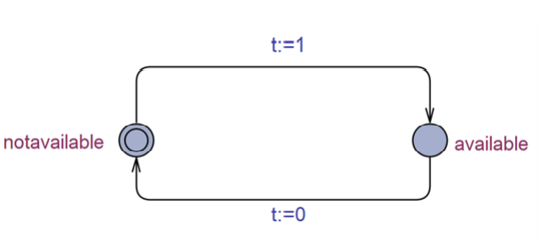
Task
Request
Idle

Slide 8
THANK YOU

Slide 9
REFERENCE
G. C. Buttazzo, Hard real-time computing systems predictable scheduling algorithms and applications. Johanneshov, Stockholm: MTM, 2013

